Slide 1
Personal Development and Intellectual Honesty
Day 2

Slide 2
Feedback on the Take Home Messages
X
X
X
X
X

Slide 3
DAY 2
INDIVIDUAL AND INSTITUTIONAL DEVELOPMENT

Slide 4
Purposes of Day 2
To discuss about institutional development
To reflect on the individual role within the institutional development plan
To elaborate an institutional development plan
To draft an individual development plan

Slide 5
INSTITUTIONAL ETHICAL CODE
Stages of Institutional Development
(adapt. from ICAI, 2017)
I - PRIMITIVE
II – RADAR SCREEN
III – MATURE
IV– HONOR CODE
No policy or procedures
(or minimalist ones)
No consistency in dealing with lack of Integrity issues
Problems rise to public debate
Administration
efforts to create policy or procedures
Policy and procedures widely known
(but not by all)
Efforts to inform
new faculty and
students about
procedures
Students play
major role in
implementing the integrity policy
Better practices and lower rates
of cheating than non-code institutions
© UNIVERSIDADE NOVA DE LISBOA 2018

Slide 6
E-learning Exercise:
In which stage is your institution?
X
X
X
X
X

Slide 7
EXERCISE 1 - STAGES OF INSTITUTIONAL DEVELOPMENT
Small Group
In which stage do each group situate the University? Why?
Discuss and confront individual and group opinions
Large group discussion
Large Group
© UNIVERSIDADE NOVA DE LISBOA 2018

Slide 8
Coffee-break

Slide 9
Rituals and Culture
Culture
Ritual
Code
Notes:
Culture – what people believe – why they do what they do
Code – the why culture is institutionalized – what is determined that should be done
Ritual – the way you materialize culture. Keeps culture meaningful. Reinforce values – what you do

Slide 10
EXERCISE 2 – RITUALS AND CULTURE
Small Group (Group’s Wall of Values)
Participants identify one gap or challenge in their institutional culture. Ex. beliefs and behaviours that their ideal team should have.
Ask participants to transform this gap/stress in the culture in terms of academic integrity by defining at least three “how might we” questions
Brainstorm 10 possible solutions to respond to one of the gaps/challenges found
© UNIVERSIDADE NOVA DE LISBOA 2018

Slide 11
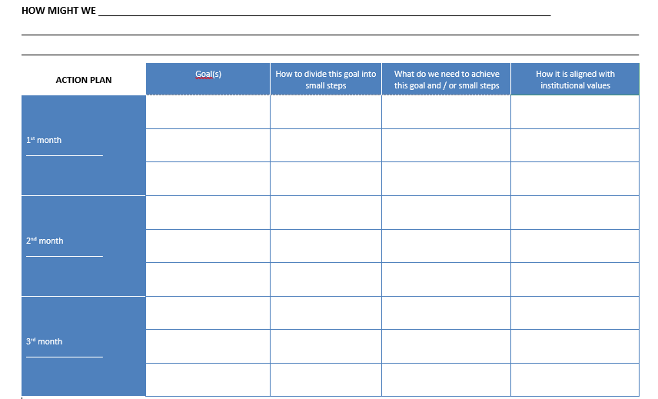
EXERCISE 3 – INSTITUTIONAL DEVELOPMENT PLAN
In group, establish a plan with phases for one of the solutions found

Slide 12
Lunch

Slide 13
PRESENTATION
INSTITUTIONAL ACTION PLANS

Slide 14
INSTITUTIONAL INNOVATION
TIPS

Slide 15
INSTITUTIONAL INNOVATION TIPS
Identify the context and respect the culture of your institution
Think about your own solutions
Start small, think big
Create an atmosphere of "buy-in"
Validate your ideas with experts

Slide 16
GROW MODEL
On my role within the institutional development plan
G
R
O
W
Goals
Reality
Options
Will
Start with the end in mind:
What do you want to achieve?
What is the desired outcome?
Let's clarify.
Listen and uncover:
Where are you now?
Clarifying the issues and obstacles
Determining the facts (uncover the facts; uncover assumptions and beliefs)
Explore options:
What are the options? (brainstorm together)
Inviting suggestions (think out of the box)
Discussing choices
Exploring consequences
Agree on action plan:
What is the action?
By when?
What support?
When to follow up?

Slide 17
EXERCISE 4 - GROW MODEL
On my role within the institutional development plan
At this point you have a Group Institutional Plan. How can you find your role in this Group Institutional Plan to create your Individual Action Plan (IAP)?
In pairs, use the given GROW Model questions. One makes the questions and the other answers. Take notes during the process for your IAP (if you think is necessary).
After 10 minutes, change roles in the pairs.

Slide 18
DEBRIEFING
How was the process?

Slide 19
DEBRIEFING Effective Communication and Active Listening Tips
Face the speaker and maintain eye contact
Keep an open mind (try to understand and do not judge)
Listen to what is being said, instead of what you will answer back
Wait for the speaker to pause to ask clarifying questions
Pay attention to what isn't said—to nonverbal cues (this is valid for your interlocutor and for you)
Show the speaker you’re listening
Summarize to make sure that you understood the message
Give the speaker regular feedback

Slide 20
DEBRIEFING Tips for an Effective Feedback
Goal-Referenced and Tangible
Actionable
Transparent and User-Friendly
Timely
Ongoing
(Source: Grant Wiggins, Educational Leadership, 2012)
Notes:
The term feedback is often used to describe all kinds of comments made after the fact, including advice, praise, and evaluation. But none of these are feedback, strictly speaking. Basically, feedback is information about how we are doing in our efforts to reach a goal.
Goal-referenced and Tangible: Information becomes feedback if, and only if, I am trying to cause something and the information tells me whether I am on track or need to change course. Any useful feedback system involves not only a clear goal, but also tangible results related to the goal.
Actionable: Effective feedback is concrete, specific, and useful; it provides actionable information. Thus, "Good job!" and "You did that wrong" and B+ are not feedback at all, they are evaluations. Feedback is based on neutral, goal-related facts that help the person to know what specifically should do more or less next time to improve results.
Transparent and User-Friendly: Even if feedback is specific and accurate in the eyes of experts or bystanders, it is not of much value if the user cannot understand it or is overwhelmed by it. Expert coaches uniformly avoid overloading performers with too much or too technical information. They tell the performers one important thing they noticed that, if changed, will likely yield immediate and noticeable improvement.They don't offer advice until they make sure the performer understands the importance of what they saw.
Timely: In most cases, the sooner I get feedback, the better.
Ongoing: Adjusting our performance depends on not only receiving feedback but also having opportunities to use it.

Slide 21
Coffee-break

Slide 22
EXERCISE 5 – INDIVIDUAL ACTION PLAN (AIP)
Now, using the insights from the GROW Model questions, fill the Individual Action Plan (IAP) individually

Slide 23
FINAL DEBRIEFING

Slide 24
YOUR COMMENTS ON…
1. Intellectual honesty:
1.1 Dimensions of intellectual honesty
1.2 Principles and values
1.3 Dilemmatic situations
1.4 Decision making
1.5 Beyond plagiarism
1.6 Academic Integrity: Teaching and learning approaches for intellectual honesty in higher education
2. Personal and professional development plan aligned with the institutional mission:
2.1 From group to team
2.2 Team building principles
2.3 Reflection on the institutional mission
2.4 The importance of individual and team roles

Slide 25
EXERCISE 6 – POST TRAINING PARTICIPANTS FEEDBACK (PTPF)
Please fill the Post Training Participants Feedback form individually

Slide 26
Thank you!

